Slide 1
Programming Assignment #3
Notes / Background

Slide 2
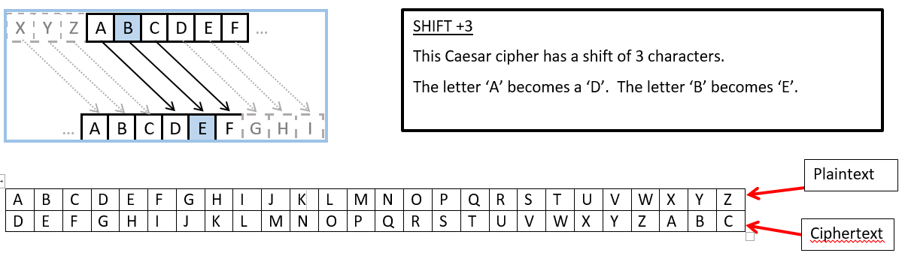
Caesar Cipher (Letter Shift)

Slide 3

Caesar Cipher (Letter Shift)
Here is a quick example of the encryption and decryption steps involved with the Caesar cipher with a shift (key) of 1.
Decryption is just as easy, by using an offset of -1.

Slide 4
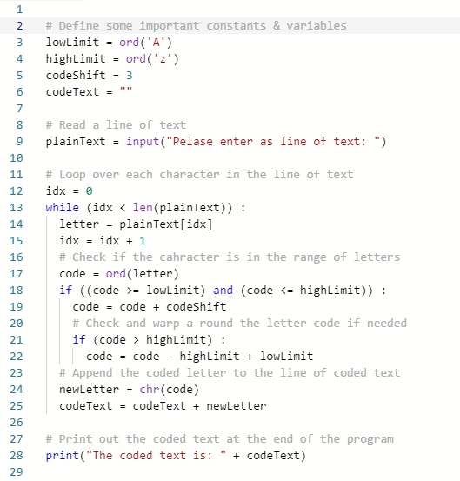
Caesar Cipher (Letter Shift)

Slide 5
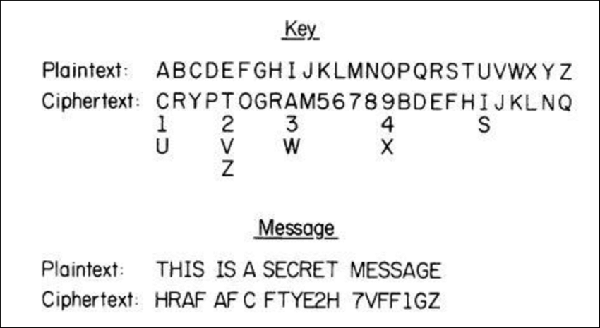
Substitution Cipher (Key Shift)
A substitution cipher is similar to a Caesar cipher except that a key is used instead of a constant numerical shift.
The Key allows each letter to be shifted in a different way.

Slide 6
Substitution Cipher (Key Shift)
The Key allows each letter to be shifted in a different way.
Cipher Key:

Slide 7
Assignment
Work with a partner to create a Substitution Cipher Key (See the assignment slide notes for more information)
Partner #1 will write a program to encode a message contained in a text file
Partner #2 will write a program to de-code the message

Slide 8
Hints
Use the sample Caesar Cipher program as a starting point
Get you program to work with single lines of text from console input / output before adding the use of files.
It is easier to debug console input / output than file input / output.
Implement your key using the list data type.

